Slide 1

Chapter: CPU/ Process Scheduling

Slide 2
CPU Scheduling : Types of Scheduling, Scheduling Algorithms, Scheduling criteria, CPU scheduler - preemptive and non preemptive, Dispatcher, First come first serve, Shortest job first, Round robin, Priority, Multi level feedback queue, multiprocessor scheduling, real time scheduling, thread
scheduling

Slide 3
Basic Concept
CPU Scheduling is basis of Multi-programmed OS
Objective of Multi-programming is to have some processes running all the time to maximize CPU Utilization.

Slide 4
Sequence of CPU and I/O Bursts
CPU Burst- when process is executed in CPU
CPU Burst Time: The amount of time the process uses the processor
Types of CPU bursts:
Long bursts -- process is CPU bound (spend max. time with CPU
Short bursts -- process is I/O bound (spend max. time with I/O)
I/O Burst- when CPU is waiting for I/O completion for further execution.

Slide 5
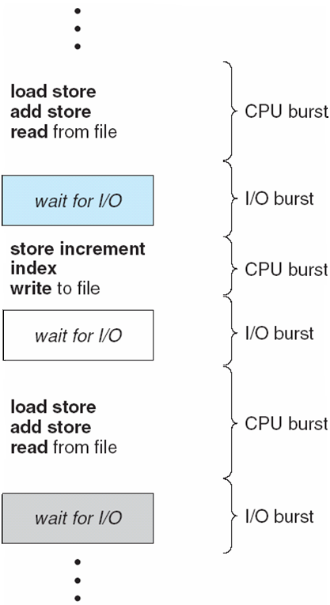
Sequence of CPU and I/O Bursts

Slide 6
CPU Scheduling Decisions
When process switches from Running State to Waiting State (i/o request or wait)
When process switches from Running to Ready State (interrupt)
When process switches from Waiting State to Ready State (at completion of i/o)
When a process terminates
1. Non-preemptive
2. Pre-emptive
3. Pre-emptive
4. Non-Preemptive (allow)

Slide 7
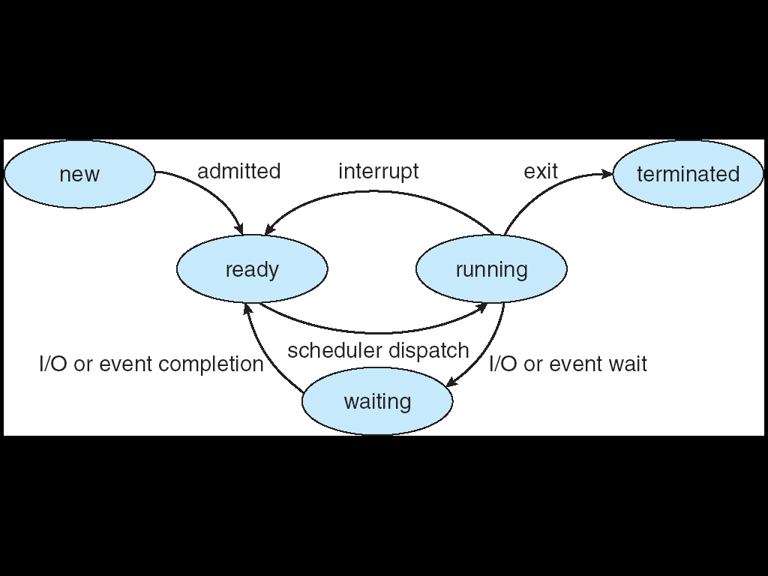
Process States

Slide 8
Scheduling
Non-Preemptive
Preemptive

Slide 9
Non-Preemptive or Cooperative Scheduling
Once the CPU is allocated to a process, process keeps the CPU until:
it releases when it completes
by switching to waiting state
E.g : 1. Windows 3.x and Apple Macintosh operating systems uses non-preemptive scheduling
2. Windows (also 10) uses a round-robin technique with a multi-level feedback queue for priority scheduling
Process is executed till completion. It cannot be interrupted. Eg First In First Out

Slide 11
Preemptive Scheduling
The running process is interrupted for some time and resumed later on, when the priority task has finished its execution.
CPU /resources is/are taken away from the process when some high priority process needs execution.

Slide 12
Dispatcher
A module that gives control of CPU to the process selected by short-term scheduler.
Functions:
Switching Context
Switching to User mode
Jumping to proper location to restart the program.
The dispatcher should be as fast as possible, given that it is invoked during every process switch
Dispatch Latency:
Time taken for the dispatcher to stop one process and start another running.

Slide 13
Scheduling Criteria
Which algorithm to use in a particular situation
1. CPU Utilization: CPU should be busy to the fullest
2. Throughput: No. of processes completed per unit of time.
Turnaround Time: The time interval from submitting a process to the time of completion.
The time interval from submitting a process to the time of completion
Turnaround Time= Time spent to get into memory + waiting in ready queue + doing I/O + executing on CPU
(It is the amount of time taken to execute a particular process)

Slide 14
Scheduling Criteria
4. Waiting Time: Time a process spends in ready queue.
Amount of time a process has been waiting in the ready queue to acquire control on the CPU.
5. Response Time: Time from the submission of a request to the first response, Not Output
6. Load Average: It is the average number of processes residing in the ready queue waiting for their turn to get into the CPU.

Slide 15
Scheduling Algorithm Optimization Criteria
Max CPU utilization
Max throughput
Min turnaround time
Min waiting time
Min response time

Slide 16
First-Come, First-Served (FCFS)
Processes that request CPU first, are allocated the CPU first
FCFS is implemented with FIFO queue.
A process is allocated the CPU according to their arrival times.
When process enters the ready queue, its PCB is attached to the Tail of queue, When CPU is free, it is allocated to the process selected from Head/Front of queue.

Slide 17
First-Come, First-Served (FCFS)
“Run until Completed:” FIFO algorithm
Example: Three processes arrive in order P1, P2, P3.
P1 burst time: 24
P2 burst time: 3
P3 burst time: 3
Draw the Gantt Chart and compute Average Waiting Time and Average Turn Around Time/Completion Time.
Sol: As arrival time is not given assume order of arrival as: P1,P2,P3
17

Slide 18
First-Come, First-Served (FCFS)
Example: Three processes arrive in order P1, P2, P3.
P1 burst time: 24
P2 burst time: 3
P3 burst time: 3
Waiting Time
P1: 0
P2: 24
P3: 27
Turnaround Time/Completion Time:
P1: 24
P2: 27
P3: 30
Average Waiting Time: (0+24+27)/3 = (51/3)= 17 milliseconds
Average Completion Time: (24+27+30)/3 = 81/3=27 milliseconds
P1
P2
P3
0
24
27
30

Slide 19
First-Come, First-Served Scheduling (1)
Simplest, non-preemptive, often having a long average waiting time
Example:
Process Burst Time
P1 24
P2 3
P3 3
P1
P2
P3
AWT = (0+24+27)/3
= 17
0 24 27 30
P2
P3
P1
AWT = (6+0+3)/3
= 3
0 3 6 30

Slide 20
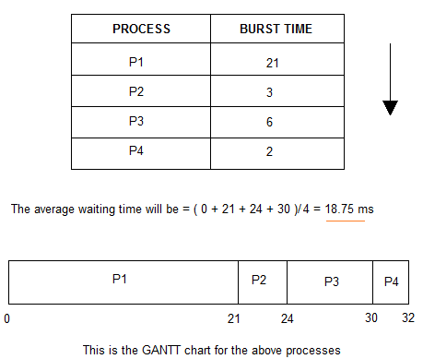
Example: First-Come, First-Served (FCFS)

Slide 21
Disadvantages of FCFS algorithm
The process with less execution time suffers i.e. waiting time is often quite long.
Here, the first process will get the CPU first, other processes can get the CPU only after the current process has finished its execution.
Now, suppose the first process has a large burst time, and other processes have less burst time, then the processes will have to wait more unnecessarily, this will result in more average waiting time, i.e., Convoy effect
This effect results in lower CPU and device utilization.
FCFS algorithm is particularly troublesome for multiprogramming systems, where it is important that each user get a share of the CPU at regular intervals.

Slide 22
Shortest Job First
Processes with least execution time are selected first.
CPU is assigned to process with less CPU burst time.
SJF:
Non-Preemption: CPU is always allocated to the process with least burst time and Process Keeps CPU with it until it is completed.
Pre-Emption: When a new process enters the queue, scheduler checks its execution time and compare with the already running process.
If Execution time of running process is more, CPU is taken from it and given to new process.

Slide 23
Shortest-Job First (SJF) Scheduling
Two schemes
nonpreemptive – once CPU given to the process it cannot be preempted until completes its CPU burst
preemptive – if a new process arrives with CPU burst length less than remaining time of current executing process, preempt. This scheme is know as the Shortest-Remaining-Time-First (SRTF)

Slide 24
Example of Non-Preemptive SJF
Process Arrival Time Burst Time
P₁ 0.0 7
P₂ 2.0 4
P₃ 4.0 1
P₄ 5.0 4
SJF (non-preemptive)
Average waiting time = [0 + (8-2) + 3 + 7]/4 = 4
P₁
P₃
P₂
P₄
0
3
7
8
12
16

Slide 25
Shortest Job First(Non-Preemptive)
Q1. Consider foll. Processes with A.T and B.T
Process A.T B.T
P1 1 7
P2 2 5
P3 3 1
P4 4 2
P5 5 8
Cal. Completion time, turn around time and avg. waiting time.

Slide 26
Example of Preemptive SJF
Process Arrival Time Burst Time
P₁ 0.0 7
P₂ 2.0 4
P₃ 4.0 1
P₄ 5.0 4
SJF (preemptive)
Average waiting time = [(16-7) + 1 + 0 +2]/4 = 3
P₁
P₂
P₃
P₂
P₄
P₁
0
2
4
5
7
11
16

Slide 27
Shortest Job First(Preemptive)
Q1. Consider foll. Processes with A.T and B.T
Process A.T B.T
P1 0 9
P2 1 4
P3 2 9
Cal. Completion time, turn around time and avg. waiting time.
SJF(Pre-emptive)-> SRTF

Slide 28
Shortest Job First(Preemptive)
Q1. Consider foll. Processes with A.T and B.T
Process A.T B.T
P1 0 5
P2 1 3
P3 2 3
P4 3 1
Cal. Completion time, turn around time and avg. waiting time.

Slide 29
Shortest Job First (SJF) [Preemptive and Non- Preemptive]:
Advantages:
Shortest jobs are favoured.
It is probably optimal, in that it gives the minimum average waiting time for a given set of processes.
Disadvantages:
SJF may cause starvation if shorter processes keep coming. This problem is solved by aging.
It cannot be implemented at the level of short-term CPU scheduling.

Slide 30
Practice: Shortest Job First (Non Preemption)
P1 burst time: 15
P2 burst time: 8
P3 burst time: 10
P4 burst time: 3
30

Slide 31
Practice: Shortest Job First (Preemption)
Process | Arrival Time | Burst Time
P1 | 0 | 8
P2 | 1 | 4
P3 | 2 | 9
P4 | 3 | 5
Notes:
31

Slide 32
Practice: Shortest Job First (Preemption)
Process | Arrival Time | Burst Time | CT | Turn around time | Waiting Time
P1 | 0 | 7 | 16
P2 | 2 | 4 | 7
P3 | 4 | 1 | 5
P4 | 5 | 4 | 11
Notes:
32

Slide 33
Priority Scheduling
A priority number (integer) is associated with each process
The CPU is allocated to the process with the highest priority (smallest integer ≡ highest priority)
Preemptive
nonpreemptive
SJF is a priority scheduling where priority is the predicted next CPU burst time
Problem ≡ Starvation – low priority processes may never execute. (At MIT, there was a job submitted in 1967 that had not be run in 1973.)
Solution ≡ Aging – as time progresses increase the priority of the process

Slide 34
An Example
Process Burst Time Priority
P1 10 3
P2 1 1
P3 2 4
P4 1 5
P5 5 2
P2
P5
P1
P3
P4
0 1 6 16 18 19
AWT = (6+0+16+18+1)/5=8.2

Slide 35
Priority Scheduling (Preemptive)
Process | Arrival Time | Priority | Burst Time | Completion Time
P1 | 1 | 5 | 4
P2 | 2 | 7 | 2
P3 | 3 | 4 | 3
Consider 4 as Highest and 7 as Lowest Priority
Notes:
35

Slide 36
Priority Scheduling (Preemptive)
Process | Arrival Time | Priority | Burst Time | Completion Time
P1 | 0 | 2 | 10
P2 | 2 | 1 | 5
P3 | 3 | 0 | 2
P4 | 5 | 3 | 20
Consider 3 as Lowest and 0 as Highest Priority
Notes:
36

Slide 37
Priority Scheduling (Preemptive)
Process | Arrival Time | Priority | Burst Time | Completion Time
P1 | 1 | 4 | 4
P2 | 2 | 5 | 2
P3 | 2 | 7 | 3
P4 | 3 | 8 | 5
P5 | 3 | 5 | 1
P6 | 4 | 6 | 2
Consider 4 as Lowest and 8 as Highest Priority
Notes:
37

Slide 38
Round Robin Scheduling
A Time Quantum is associated to all processes
Time Quantum: Maximum amount of time for which process can run once it is scheduled.
RR scheduling is always Pre-emptive.

Slide 39
Example of RR with Time Quantum = 20
Process Burst Time
P₁ 53
P₂ 17
P₃ 68
P₄ 24
The Gantt chart is:
Typically, higher average turnaround than SJF, but better response
P₁
P₂
P₃
P₄
P₁
P₃
P₄
P₁
P₃
P₃
0
20
37
57
77
97
117
121
134
154
162

Slide 40
Round Robin
TQ: 2
Process | Arrival Time | Burst Time | Completion Time
P1 | 0 | 5 | 10
P2 | 1 | 7 | 13
P3 | 2 | 1 | 5
Process | Arrival Time | Burst Time | Completion Time
P1 | 0 | 3
P2 | 3 | 4
P3 | 4 | 6
Notes:
40

Slide 41
Round Robin
TQ: 2
Process | Arrival Time | Burst Time | Completion Time
P1 | 0 | 4
P2 | 1 | 5
P3 | 2 | 2
P4 | 3 | 1
P5 | 4 | 6
P6 | 6 | 3
Notes:
41

Slide 42
Round Robin (RR):
Advantages:
Every process gets an equal share of the CPU.
RR is cyclic in nature, so there is no starvation.
Disadvantages:
Setting the quantum too short increases the overhead and lowers the CPU efficiency, but setting it too long may cause a poor response to short processes.
The average waiting time under the RR policy is often long.
If time quantum is very high then RR degrades to FCFS.

Slide 43
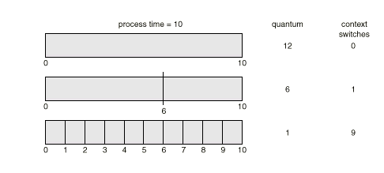
Time Quantum and Context Switch Time

Slide 44
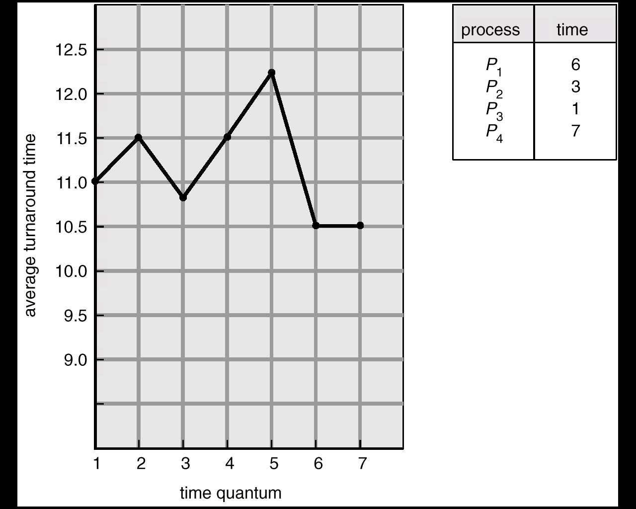
Turnaround Time Varies With The Time Quantum
5 3 1 5 1 2
15+
8+
9+
17 = 49
49/4 = 12.25

Slide 45
Multilevel Queue
A multilevel queue scheduling algorithm partitions the ready queue into several separate queues.
For Example: a multilevel queue scheduling algorithm with five queues, listed below in order of priority:
1. System processes
2. Interactive processes
3. Interactive editing processes
4. Batch processes
5. Student/ user processes

Slide 46
Multilevel Queue
A process can move between various queues
Multilevel Queue Scheduler defined by the following parameters:
No. of queues
Scheduling algorithms for each queue
Method used to determine when to upgrade / demote a process
Method used to determine which queue a process will enter and when that process needs service.

Slide 47
Multilevel Queue
Processes can be :
Foreground Process: processes that are running currently → RR Scheduling is applied
Background Process: Processes that are running in the background but its effects are not visible to user. →FCFS
Multilevel queue scheduling divides ready queue into several queues.
Processes are permanently assigned to one queue on some property like memory size, process priority, process type.
Each queue has its own scheduling algorithm

Slide 48
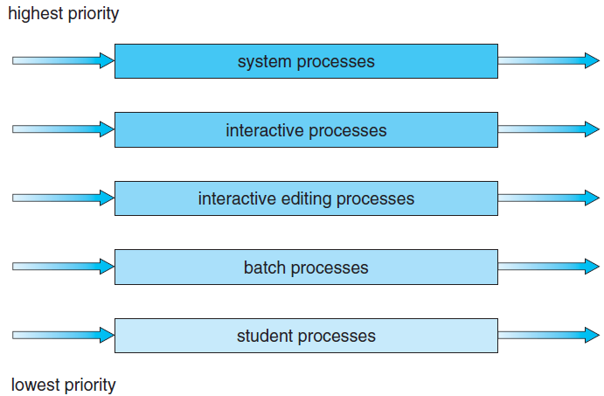
Multilevel Queue

Slide 49
Multilevel Queue
As different type of processes are there so all cant be put into same queue and apply same scheduling algorithm.
Disadvantages:
Until high priority queue is not empty, No process from lower priority queues will be selected.
Starvation for lower priority processes
Advantage:
Can apply separate scheduling algorithm for each queue.

Slide 50
Practice: Multilevel Queue
Process | Arrival Time | Burst Time | Queue
P1 | 0 | 4 | 1
P2 | 0 | 3 | 1
P3 | 0 | 8 | 2
P4 | 10 | 5 | 1
Priority of queue 1 is greater than queue 2. queue 1 uses Round Robin (Time Quantum = 2) and queue 2 uses FCFS.
Notes:
50

Slide 51


Slide 52
Multilevel Feedback Queue
Solution is: Multilevel Feedback Queue
If a process is taking too long to execute.. Pre-empt it send it to low priority queue.
Don’t allow a low priority process to wait for long.
After some time move a least priority process to high priority queue → Aging

Slide 53
Multilevel Feedback Queue
Allows a process to move between queues.
The idea is to separate processes according to the characteristics of their CPU bursts.
If a process uses too much CPU time, it will be moved to a lower-priority queue.
This scheme leaves I/O-bound and interactive processes in the higher-priority queues.
In addition, a process that waits too long in a lower-priority queue may be moved to a higher-priority queue. This form of aging prevents starvation.

Slide 54
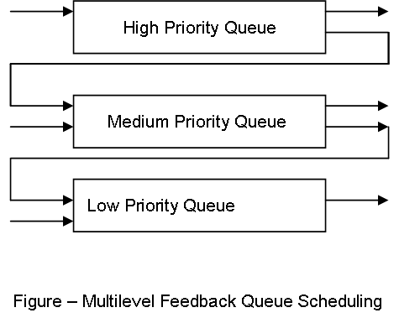
Multilevel Feedback Queue

Slide 55
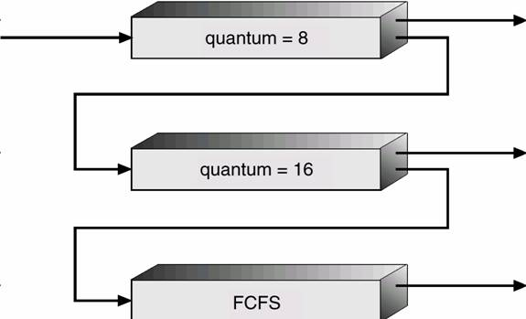
Multilevel Feedback Queue

Slide 56
Multi-processor Scheduling
Concerns:
If multiple CPUs are available, load sharing becomes possible.
Concentration is on systems in which the processors are identical—homogeneous in terms of their functionality.
Use any available processor to run any process in the queue

Slide 57
Approaches to Multiple-Processor Scheduling
1. Asymmetric multiprocessing
All scheduling decisions, I/O processing, and other system activities handled by a single processor—the master server. The other processors execute only user code.
Only one processor accesses the system data structures, reducing the need for data sharing.

Slide 58
Approaches to Multiple-Processor Scheduling
2. Symmetric multiprocessing (SMP)
Each processor is self-scheduling.
All processes may be in a common ready queue, or each processor may have its own private queue of ready processes.
Scheduling proceeds by having the scheduler for each processor examine the ready queue and select a process to execute.
Virtually all modern operating systems support SMP, including Windows, Linux, and Mac OS X

Slide 59
Issues concerning SMP systems
1. Processor Affinity
(a process has an affinity for the processor on which it is currently running.)
Consider what happens to cache memory when a process has been running on a specific processor?
The data most recently accessed by the process populate
the cache for the processor. As a result, successive memory accesses by the process are often satisfied in cache memory.

Slide 60
Issues concerning SMP systems
1. Processor Affinity
If the process migrates to another processor.
The contents of cache memory must be invalidated for the first processor, and the cache for the second processor must be repopulated.

Slide 61
Issues concerning SMP systems
1. Processor Affinity
Because of the high cost of invalidating and repopulating caches, most SMP systems try to avoid migration of processes from one processor to another and instead attempt to keep a process running on the same processor.
This is known as processor affinity—that is, a process
has an affinity for the processor on which it is currently running.

Slide 62
Issues concerning SMP systems
Forms of Processor Affinity
1. Soft affinity
When an operating system has a policy of attempting to keep a process running on the same processor—but not guaranteeing that it will do so—we have a situation known as soft affinity.
2. Hard affinity
Assign a processor to a particular process and do not allow it to migrate. Guarantees that process will remain on a single processor.

Slide 63
Issues concerning SMP systems
Hard affirnity
Example:
Many systems provide both soft and hard affinity.
For example, Linux implements soft affinity, but it also provides the schedsetaffinity() system call, which supports hard affinity.

Slide 64
Issues concerning SMP systems
2. Load Balancing
On SMP systems, it is important to keep the workload balanced among all processors to fully utilize the benefits of having more than one processor.
Need of Load Balancing
One or more processors may sit idle while other processors have high workloads, along with lists of processes awaiting the CPU.

Slide 65
Issues concerning SMP systems
2. Load Balancing
Load balancing is necessary only on systems where each processor has its own private queue of eligible processes to execute.
On systems with a common run queue, load balancing is often unnecessary, because once a processor becomes idle, it immediately extracts a runnable process from the common run queue.
In most operating systems that support SMP, each processor have a private queue of eligible processes.

Slide 66
Issues concerning SMP systems
2. Load Balancing
Two approaches to load balancing: push migration and pull
migration.
1. Push migration: a specific task periodically checks the
load on each processor and—if it finds an imbalance—evenly distributes the load by moving (or pushing) processes from overloaded to idle or less-busy processors.
2. Pull migration: occurs when an idle processor pulls a waiting task from a busy processor.

Slide 67
Issues concerning SMP systems
3. Multicore Processors
A multi-core processor is a single computing component with two or more independent processing units called cores, which read and execute program instructions.
A processor, or more commonly a CPU, is an individual processing device. It may contain multiple cores.
A core is a bank of registers and dedicated cache
Core is a structure that performs all of a processor's tasks, but is not an entire processor.

Slide 68
Issues concerning SMP systems
3. Multicore Processors
The instructions are ordinary CPU instructions (such as add, move data, and branch) but the single processor can run multiple instructions on separate cores at the same time, increasing overall speed for programs.
Manufacturers typically integrate the cores onto a single integrated circuit

Slide 69
Issues concerning SMP systems
3. Multicore Processors
SMP systems have allowed several threads to run concurrently by providing multiple physical processors.
In computer system, multiple processor cores are placed on the same physical chip, resulting in a multicore processor.
Each core maintains its architectural state and appears to the operating system to be a separate physical processor.

Slide 70
Issues concerning SMP systems
3. Multicore Processors
Multicore processors may complicate scheduling issues:
When a processor accesses memory, it spends a significant amount of time waiting for the data to become available. This situation, known as a memory stall.
Memory Stall may occur due to a cache miss (accessing data that are not in cache memory).

Slide 71
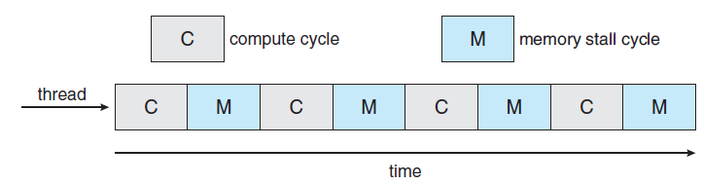
Issues concerning SMP systems
Memory Stall
the processor can spend up to 50 percent of its time waiting for data to become available from memory.

Slide 72
Issues concerning SMP systems
Solution to Memory Stall Problem
To remedy this situation, hardware designs have implemented
multithreaded processor cores in which two (or more) hardware threads are assigned to each core.
If one thread stalls while waiting for memory, the core can switch to another thread.

Slide 73
Real Time Scheduling
A real-time operating system (RTOS) is intended to serve real-time applications that process data without buffer delays.
a) soft real-time systems b) hard real-time systems
A hard real-time system considers timelines as a deadline, and it should not be omitted in any circumstances.
A soft real-time system is a system whose operation is degraded if results are not produced according to the specified timing requirement.
(The meeting of deadline is not compulsory for every task)

Slide 74
Priority based real-time scheduling
priority-based scheduling algorithms assign each process a priority based on its importance;
more important tasks are assigned higher priorities than less important.
If the scheduler also supports preemption, a process currently running on the CPU will be preempted if a higher-priority process becomes available to run.
A preemptive, priority-based scheduler only guarantees
soft real-time functionality.

Slide 75
Priority based real-time scheduling
Example
Linux, Windows, and Solaris operating systems assign real-time processes the highest scheduling priority.
For example Windows has 32 different priority levels. The highest levels—priority values 16 to 31—are reserved for real-time processes.

Slide 76
Priority based scheduling for hard real-time
Hard real-time systems must guarantee that real-time tasks will be serviced in accord with their deadline requirements.
Characteristics of the processes that are to be scheduled:
The processes are considered periodic.
i.e They require the CPU at constant intervals (periods).

Slide 77
Priority based scheduling for hard real-time
Once a periodic process has acquired the CPU, it has a fixed processing time t, a deadline d by which it must be serviced by the CPU, and a period p.
The relationship of the processing time, the deadline, and
the period can be expressed as 0 ≤ t ≤ d ≤ p.
The rate of a periodic task is 1/p.

Slide 78
Priority based scheduling for hard real-time
Schedulers assign priorities according to a process’s deadline or rate requirements.
A process may have to announce its deadline requirements to the scheduler.
Scheduler uses an admission-control algorithm to perform following:
It either admits the process, guaranteeing that the process will complete on time.
Rejects the request as impossible if it cannot guarantee that the task will be serviced by its deadline.

Slide 79
Rate-Monotonic Scheduling
The rate-monotonic scheduling algorithm schedules periodic tasks using a static priority policy with preemption.
rate-monotonic scheduling (RMS) is a priority assignment algorithm used in real-time operating systems (RTOS) with a static-priority scheduling class.
The static priorities are assigned according to the cycle duration of the job, so a shorter cycle duration results in a higher job priority

Slide 80
Rate-Monotonic Scheduling
RMS assigns priorities to tasks on the basis of their periods.
The highest-priority task is the one with the shortest period, the second highest-priority task is the one with the second shortest period, and so on.
When more than one task is available for execution, the one with the shortest period is serviced first.
Plot the priority of tasks as a function of their rate -> results a monotonically increasing function.
( Name is Rate Monotonic Scheduling)

Slide 81
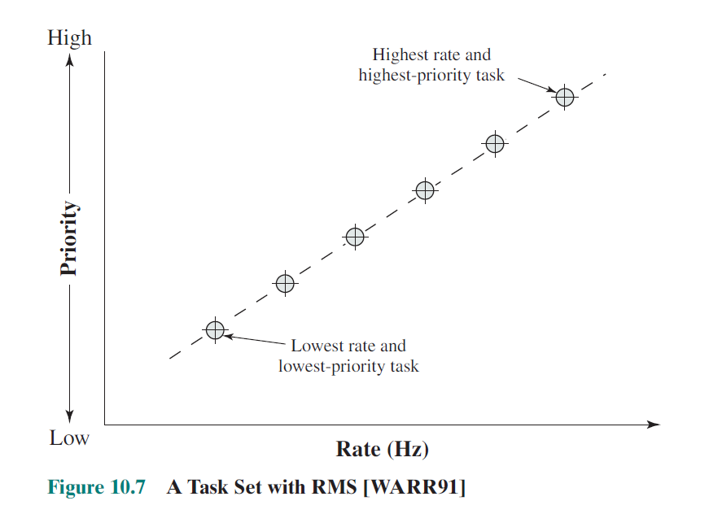
Rate-Monotonic Scheduling

Slide 82
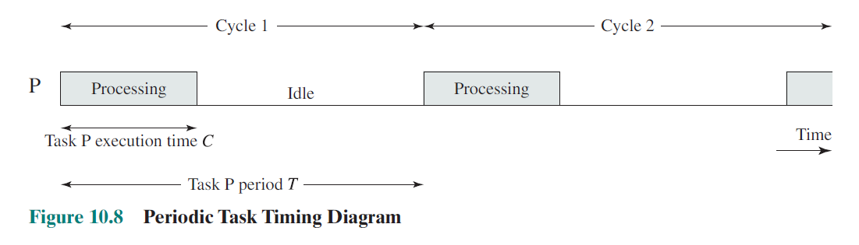
The task’s period, T, is the amount of time between the arrival of one instance of
the task and the arrival of the next instance of the task.
A task’s rate is simply the inverse of its period (in seconds).
The execution time, C, is the amount of processing time required for each
Occurrence of the task.

Slide 83
Rate-Monotonic Scheduling
rate-monotonic scheduling assumes that the processing time of
a periodic process is the same for each CPU burst.
For example
Consider P1, P2 with time period 50,100 resp. and B.T 20,35 resp.
Cal. CPU utilization of each process and total CPU utilization.
Sol:
CPU utilization=(Burst time/Time period)= (Ti/Pi)
For P1: (20/50)=0.40 i.e 40%
For P2: (35/100)=0.35 i.e 35%
Total CPU utilization is 75%

Slide 84
Rate-Monotonic Scheduling
rate-monotonic scheduling assumes that the processing time of
a periodic process is the same for each CPU burst.
For example
Consider t1,t2,t3 with time period 100,150,350 resp. and B.T 20,40,100 resp. U1, U2, U3 ?

Slide 85
Rate-Monotonic Scheduling
Consider 2 processes P1 , P2. Time Period: 50,100 resp. Burst time: 20,35. Schedule processes using Rate monotonic scheduling
Note: if CPU utilization is less than 80% only then it can be scheduled by rate monotonic scheduling. So before scheduling find Over all CPU utilization.
Consider 2 processes P1 , P2. Time Period: 50,70 resp. Burst time: 20,35. Schedule processes using Rate monotonic scheduling

Slide 86
Rate-Monotonic Scheduling
Rate-monotonic scheduling has a limitation:
CPU utilization is bounded, and it is not always possible fully to maximize CPU resources.
The worst-case CPU utilization for scheduling N processes is
N(2^1/N − 1)

Slide 87
Earliest Deadline First Scheduling
Earliest-deadline-first (EDF) scheduling dynamically assigns priorities according to deadline.
The earlier the deadline, the higher the priority the later the
deadline, the lower the priority.
Under the EDF policy, when a process becomes runnable, it must announce its deadline requirements to the system. Priorities
may have to be adjusted to reflect the deadline of the newly runnable process.

